Slide 1
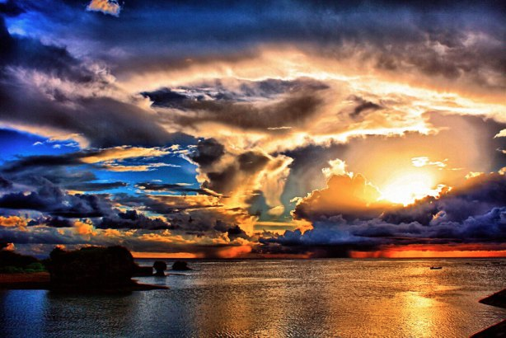
How to Be a Blessing
Matthew 5:13-16
Dr. Rick Griffith, Crossroads International Church
www.biblestudydownloads.org

Slide 2
You're Doing Well
Notes:
Interest:
It brings me great joy to see our people have a beneficial influence others:
1. I see among us people bringing their family and friends to church.
2. I know that some of you are having others over to your place or visiting one another to offer encouragement.
3. One of you told me yesterday that, after early years of drinking, you have not had a drink for 31 years—and that this has caused people at work to wonder why you don't get drunk at company parties.

Slide 3
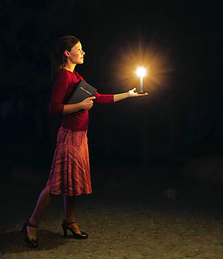
How are you impacting others today?
Subtitle
Notes:
Need:
How are you impacting others today? Are you influencing others for good?
Do your colleagues live a purer life because of your influence?
Is your family more like Jesus because you are in the family that you are in?

Slide 4
Do people want to listen to you?
Notes:
So people want to listen to you?
How do you really impact others—really?

Slide 5
How can we bless others?
Salt & Light

Slide 6
You may be the only Bible that others read.

Slide 7
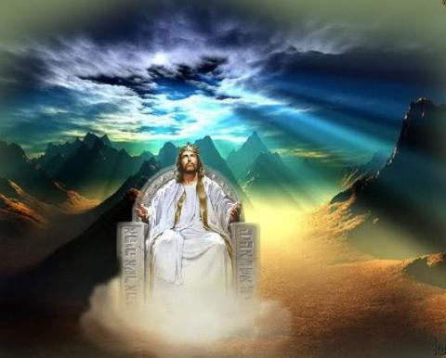
When Jesus is King… (Matthew 5–7)
What would your life look like if Christ was truly the boss of your life?
Notes:
The Sermon on the Mount (Matt 5–7) show what it looks like when someone has changed his thinking about Christ—the "fruits" of repentance.

Slide 8
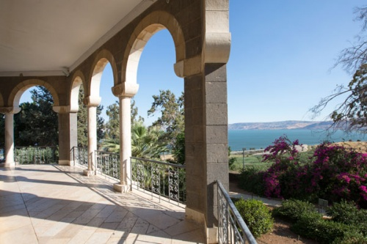
"Blessed are the…"
Notes:
Last week we saw that at the spot where a beautiful church now stands Jesus declared, “Blessed are the…”

Slide 9
Beatitudes
POOR IN SPIRIT
MOURN
MEEK
HUNGER & THIRST FOR RIGHTEOUSNESS
MERCIFUL
PURE OF HEART
PEACEMAKERS
PERSECUTED
Notes:
Then Jesus gave the qualities expected of one who accepts him as King.

Slide 10
…for they…
…for theirs is the kingdom of heaven
will be comforted
will inherit the earth
will be filled
will be shown mercy
will see God
will be called sons of God
…for theirs is the kingdom of heaven
Notes:
We saw that Jesus had just finished sharing with his disciples how to be blessed in the Beatitudes of Matthew 5:1-12. This blessing included rewards now and in the future earthly kingdom when believers rule with Christ for 1000 years.
Such blessings come from living the pure lifestyle described in verse 3-12.

Slide 11
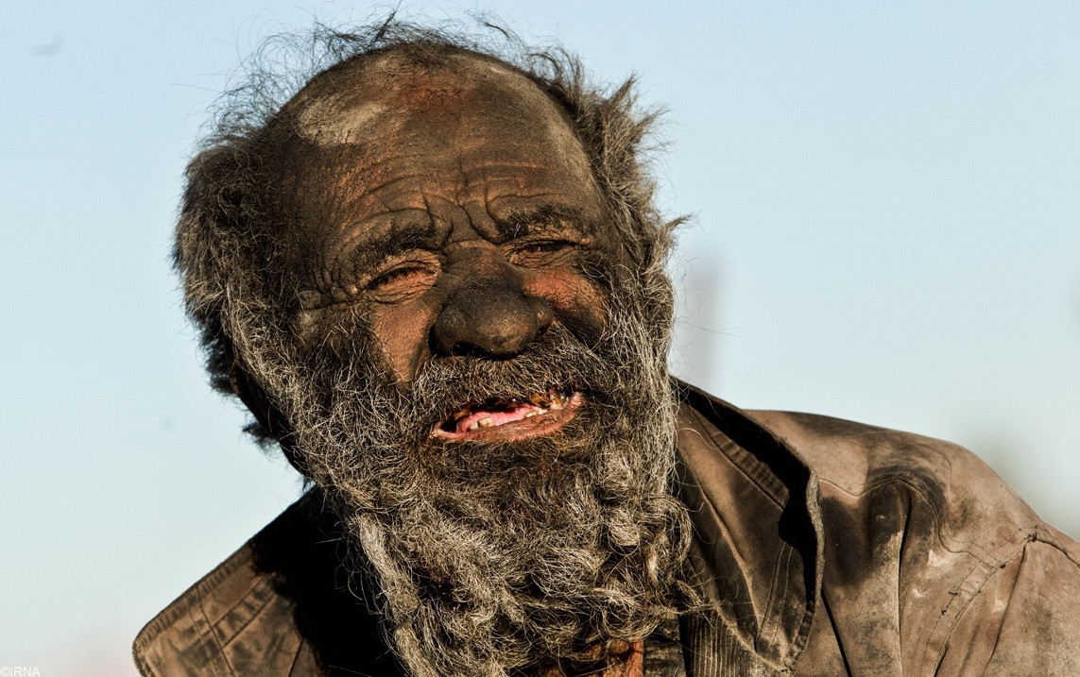
Must we be hermits to be pure?
Notes:
But living such a counter-cultural way might make us think that we ought to be hermits or unengaged in the world around us. Lest we think that way, we must read on to the following verses.

Slide 12
How to be blessed (1-12)
How to be a blessing (13-16)
Website
Notes:
Now that Christ had shared how to be blessed (5:1-12), we see the flip side of this: how to be a blessing to others.
• Some consider verses 13-16 a continuation of the Beatitudes since they still speak of the nature of those who know Christ—the attitudes and character they should show.

Slide 13
Salt & Light
Subtitle
Notes:
In any case, the command here is to influence others positively just as salt and light do in our lives

Slide 14
Salt & Light
Subtitle
Notes:
Jesus talked about blessing others with two familiar metaphors—salt and light—and he made two declarations—“You are the salt of the earth” and “You are the light of the world.” Today we’ll see what he meant by these in order—first salt and then light.

Slide 15
Salt & Light
Matthew 5:13-16
Notes:
Matthew 5:13-16 is our text today.

Slide 16
"You are the salt of the earth. But what good is salt if it has lost its flavor? Can you make it salty again? It will be thrown out and trampled underfoot as worthless" (5:13 NLT).

Slide 17
"You are the light of the world—like a city on a hilltop that cannot be hidden. ¹⁵No one lights a lamp and then puts it under a basket. Instead, a lamp is placed on a stand, where it gives light to everyone in the house. ¹⁶In the same way, let your good deeds shine out for all to see, so that everyone will praise your heavenly Father" (5:14-16 NLT).

Slide 18
How can we bless others?
Salt & Light
Notes:
The first way we can bless others is to…

Slide 19
I. Help people hunger for God (13).
Subtitle
Notes:
Live in such a way that you cause people to want to know who God is.

Slide 20
Be Salt
Subtitle
Notes:
I first thought this meant to make people thirsty of God—but who likes to drink salt water?

Slide 21
What does that mean?
Subtitle
Notes:
Salt had many useful purposes in biblical times. So the scholars have at least 11 different interpretations of “salt” here!

Slide 22
—A preservative?
Salt of the earth
Notes:
I have often heard that it was used as a preservative, but I don’t know of even one Bible text that uses it in this way
_______
Held by Blomberg, 102, and Hunter, A Pattern for Life, 44; cited by Stanley D. Toussaint, Behold the King (Portland: Multnomah, 1980), 98.

Slide 23
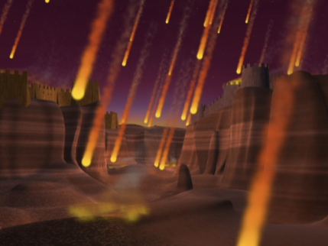
The Destruction of Sodom
Notes:
Salt sometimes denotes judgment

Slide 24
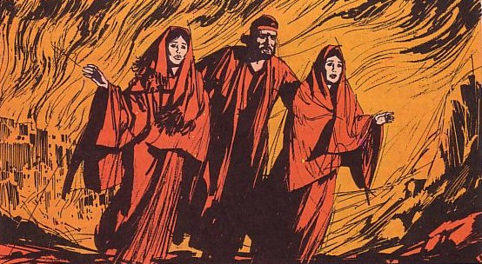
Lot in Genesis 19
Notes:
God is serious about sin, but his pattern is to take the righteous away before judging sin—as in the case of Noah.

Slide 25
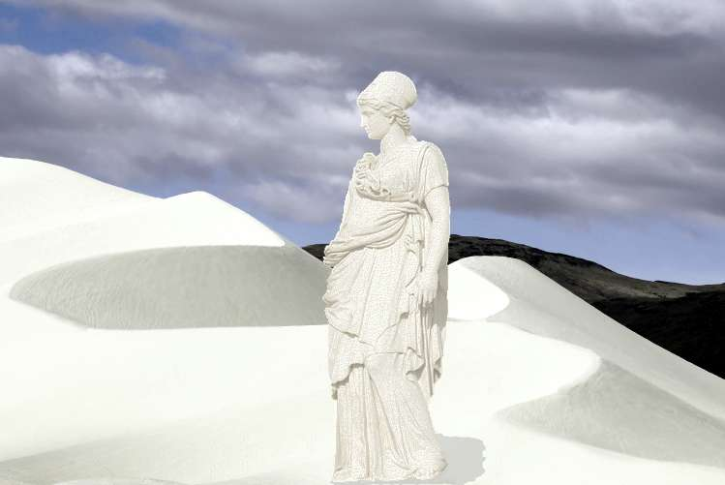
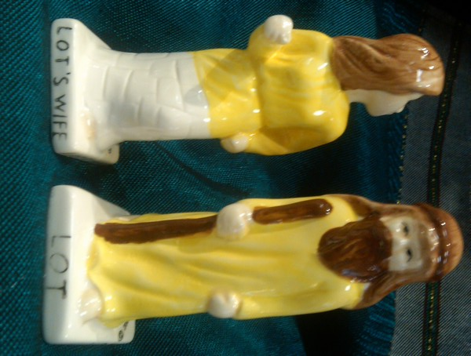
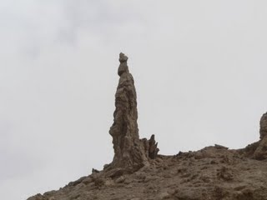
"Remember Lot's wife" (Luke 17:32)
Notes:
A pillar stands at the Dead Sea that is called "Lot's wife."
You can even buy slat and pepper shakers called "Lot and Lot's Wife." Guess which one is salt?
A Sunday School teacher was once describing how Lot's wife looked back and turned into a pillar of salt, when little Jason interrupted, 'My Mommy looked back once while she was driving,' he announced triumphantly, 'and she turned into a telephone pole!'

Slide 26
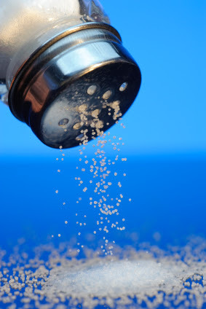
"Season all your grain offerings with salt to remind you of God's eternal covenant. Never forget to add salt to your grain offerings" (Lev 2:13 NLT).
Notes:
Hmmm, but that doesn't seem to help!

Slide 27
= Enhance taste!
Subtitle
Notes:
Enhancing taste is the main idea here: Salt brought out the taste in food

Slide 28
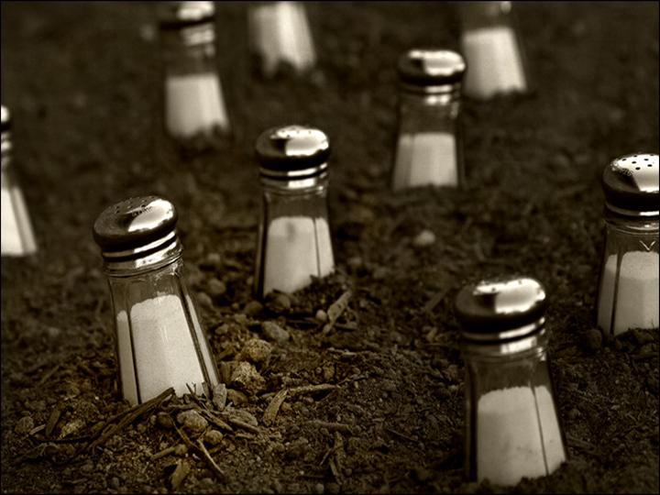
"Salt is good for seasoning. But if it loses its flavor, how do you make it salty again? ³⁵Flavorless salt is good neither for the soil nor for the manure pile. It is thrown away. Anyone with ears to hear should listen and understand!" (Luke 14:34-35 NIV).
Notes:
The main use seems to be seasoning food so it tastes good—or for making the soil more productive (“The disciples were left here to cause the world to bring forth fruit for God,” Toussaint, 98).

Slide 29
"Let your conversation be always full of grace, seasoned with salt, so that you may know how to answer everyone" (Col 4:6 NLT).

Slide 30
Don't gush!
Subtitle

Slide 31
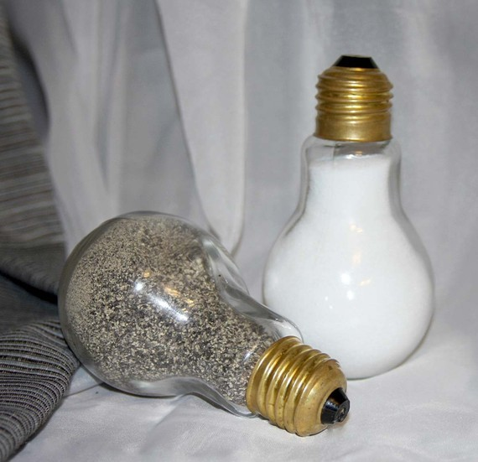
Be Salt
Subtitle
Notes:
As society’s “salt” we must “season” our speech with unbelievers so they want what we have in Christ (Col. 4:6). Don’t be pepper to make people sneeze!

Slide 32
Be Salt
Subtitle
Notes:
We should try to avoid offending people without changing the nature of the gospel

Slide 33
Avoid Offense
"MFT"
Women elders?
Notes:
This doesn’t mean we must abandon biblical language to be relevant. MFT (Marriage & Family Therapy) is now prohibited in the USA, to be replaced with CFT (Couples & Family Therapy) as some are offended by the term “marriage.”
• This doesn’t mean we exalt relevance over the Bible. People have asked why CIC does not have women elders. Our response is that a woman cannot be “the husband of one wife” (1 Tim 3:2). No one ever disputed this.

Slide 34
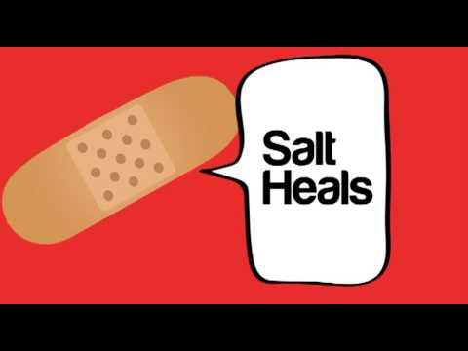
Salt heals.
Notes:
Positive examples show how we enhance the taste for Christ in society.

Slide 35
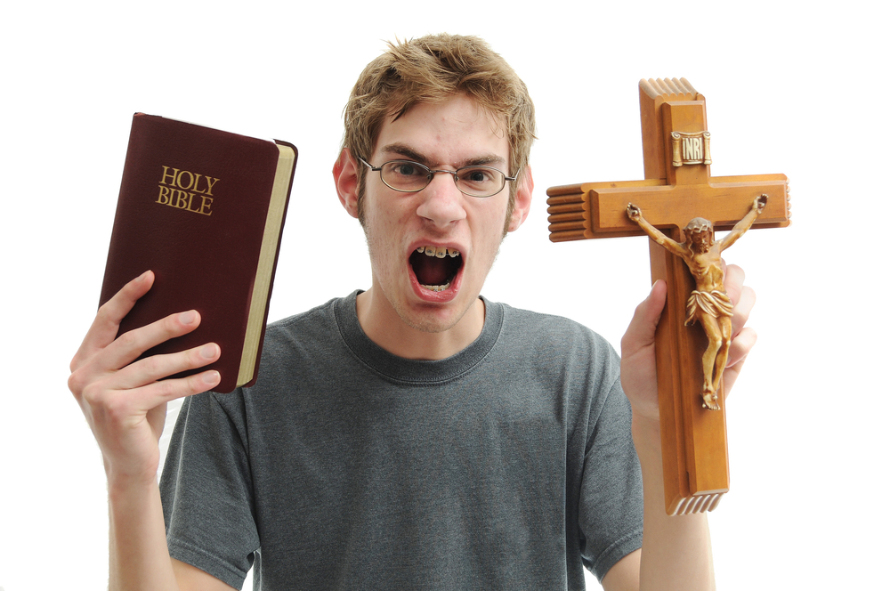
How do those who don't attend church perceive us?
Notes:
Believers feed the poor, help marriages, etc. (TBN video) without expecting people to become Christians.

Slide 36
A Woman on the Plane Asked This Pastor What He Does. His Answer is Shockingly Awesome.
Notes:
http://www.churchleaders.com/daily-buzz/265718-a-woman-on-the-plane-asked-this-pastor-what-he-does-his-answer-is-shockingly-awesome.html
How To Explain What You Do, When You're A Pastor
Trinity Broadcasting Network
Published on Nov 13, 2014
A TBN Interview with Pastor J. John: How to explain what you do, when you're a pastor! A must see video! (Slice 2014-10-29) To watch the entire interview, go to this link: http://bit.ly/1EuXNOB
https://www.youtube.com/watch?v=L6TGxKvSqH8

Slide 37
http://www.churchleaders.com/daily-buzz/265718-a-woman-on-the-plane-asked-this-pastor-what-he-does-his-answer-is-shockingly-awesome.html
Notes:
How To Explain What You Do, When You're A Pastor
Trinity Broadcasting Network
Published on Nov 13, 2014
A TBN Interview with Pastor J. John: How to explain what you do, when you're a pastor! A must see video! (Slice 2014-10-29) To watch the entire interview, go to this link: http://bit.ly/1EuXNOB
https://www.youtube.com/watch?v=L6TGxKvSqH8

Slide 38
How To Explain What You Do, When You're A Pastor.mp4
Notes:
To Explain What You Do, When You're A Pastor
Trinity Broadcasting Network
Published on Nov 13, 2014
A TBN Interview with Pastor J. John: How to explain what you do, when you're a pastor! A must see video! (Slice 2014-10-29) To watch the entire interview, go to this link: http://bit.ly/1EuXNOB
https://www.youtube.com/watch?v=L6TGxKvSqH8

Slide 39
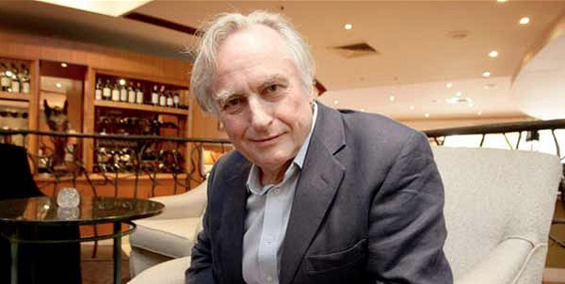
Richard Dawkins, 2010
"There are no Christians, as far as I know, blowing up buildings. I am not aware of any Christian suicide bombers. I am not aware of any majority Christian denomination that believes the penalty for apostasy is death…
I have mixed feelings about the decline of Christianity, in so far as Christianity might be a bulwark against something worse."
Notes:
The noted atheist, Richard Dawkins, praised Christians for being salt.
________
Richard Dawkins, noted atheist, praises Christianity
'No Christians, as far as I know, blowing up buildings'
Published: 01/12/2016 at 12:01 PM image: http://www.wnd.com/files/2014/07/cchumley_avatar.jpg
By Cheryl Chumley
Read more at http://www.wnd.com/2016/01/richard-dawkins-noted-atheist-praises-christianity/#Bo7L1Sypw0CmT1KB.99
http://www.wnd.com/2016/01/richard-dawkins-noted-atheist-praises-christianity/
Accessed 27 Jan 2016

Slide 40
Salt & Light
Subtitle
Notes:
Christians who don’t create a hunger for God in others are useless (5:13b).

Slide 41
How can we bless others?
Salt & Light
Notes:
The first way we can bless others is to help people hunger for God. That’s what it means to be “salt of the earth.” Now the second way to bless others is to be the “light of the world.” What does that mean? This second way to bless others is to…

Slide 42
I. Help people hunger for God (13).
Subtitle
Notes:
The first way we can bless others is to help people hunger for God. That’s what it means to be “salt of the earth.” Now the second way to bless others is to be the “light of the world.” What does that mean? This second way to bless others is to…

Slide 43
II. Lead people to God so they'll praise him (5:14-16).
Subtitle
Notes:
Show God’s holiness so others credit him for the good they see in you.

Slide 44
Be Light
Subtitle
Notes:
Light back then functioned as it does for us today.

Slide 45
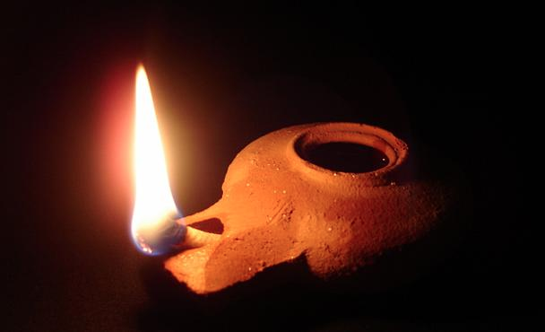
Herodian Lamp
"First Century Flashlight"
Notes:
Here is a Herodian lamp that I purchased in Israel.
Yes, it’s a genuine, 2000-year-old lamp, minus the oil that went inside. You might think this really special, and it is. In fact, it’s the oldest thing that I own. Just to let you know how much I love and trust you, I will pass it around so each of you can hold it.
But the truth is, thousands of these have been unearthed in excavations, so it’s only worth about $20. Basically, it’s a first-century flashlight or torch. Nearly everyone had one.

Slide 46
Be Light
Subtitle
Notes:
Jesus said that every believer is one!
People stumble in darkness because they can’t see their way.
However, a lighted path shows us the way we should go.
“Jesus obviously has in mind the bringing of illumination through the revelation of God’s will for his people” (Blomberg, 103).

Slide 47
How to Be Light…
Reveal Truth
Notes:
Christians should reveal truth: both God and sin.

Slide 48
Be Light
Subtitle
Notes:
Light shows reality while darkness hides reality. Turning on the light doesn’t make things bad—it only shows the true state of things.
Once when my sons were small, I put them to bed and went to the door to leave. As I reached for the switch, one of them said, “Dad, don’t turn on the darkness!”
Don’t try that with a “preacher Dad”! Why? Because that became a teachable moment. I went over to him and said, “Son, you cannot turn on darkness. Darkness is the way things are, but light puts away that darkness.”

Slide 49
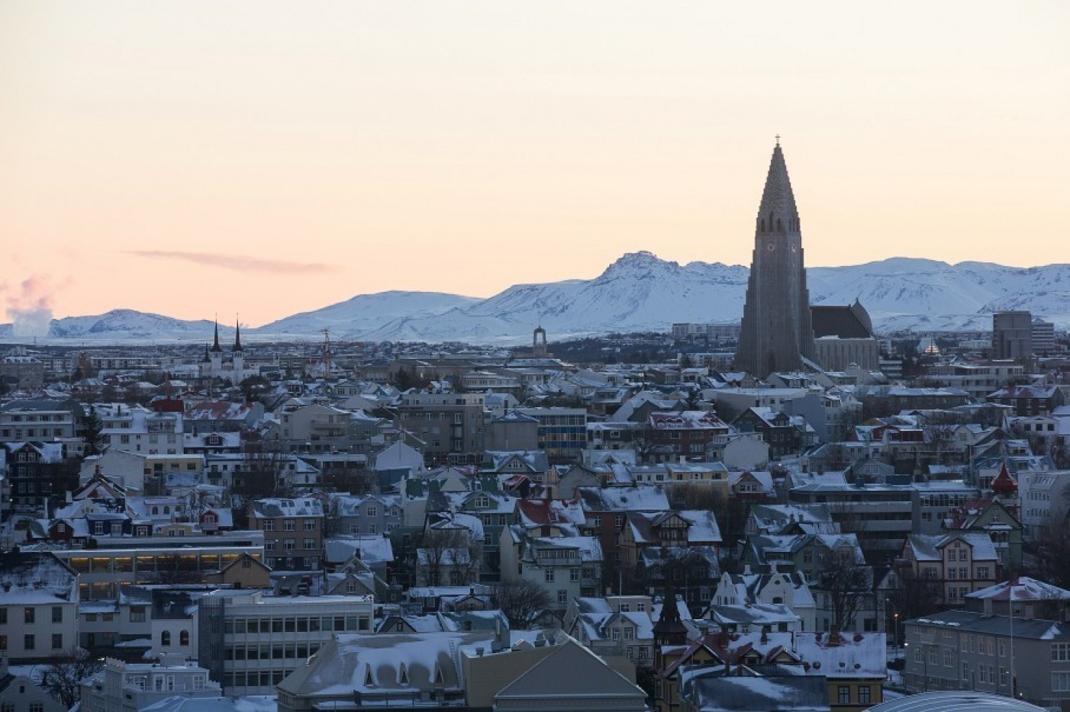
Iceland
In this country, literally no young Christians believe that God created the Earth.
Notes:
Sadly, believers in this country have not defended the truth of Genesis 1.
• Which country? Iceland!
The Washington Post on 23 January 2016 reports…
"LONDON — If you happen to have the chance to talk to young Icelanders about their religious beliefs, be prepared for a surprise. Exactly zero percent of respondents in a recent survey said they believe that God created the Earth..."
https://www.washingtonpost.com/news/worldviews/wp/2016/01/23/in-this-country-literally-no-young-christians-believe-that-god-created-the-earth/
Image: The spire of Hallgrimskirkja church stands above residential and commercial property on the city skyline in Reykjavik. (Arnaldur Halldorsson/ Bloomberg)

Slide 50
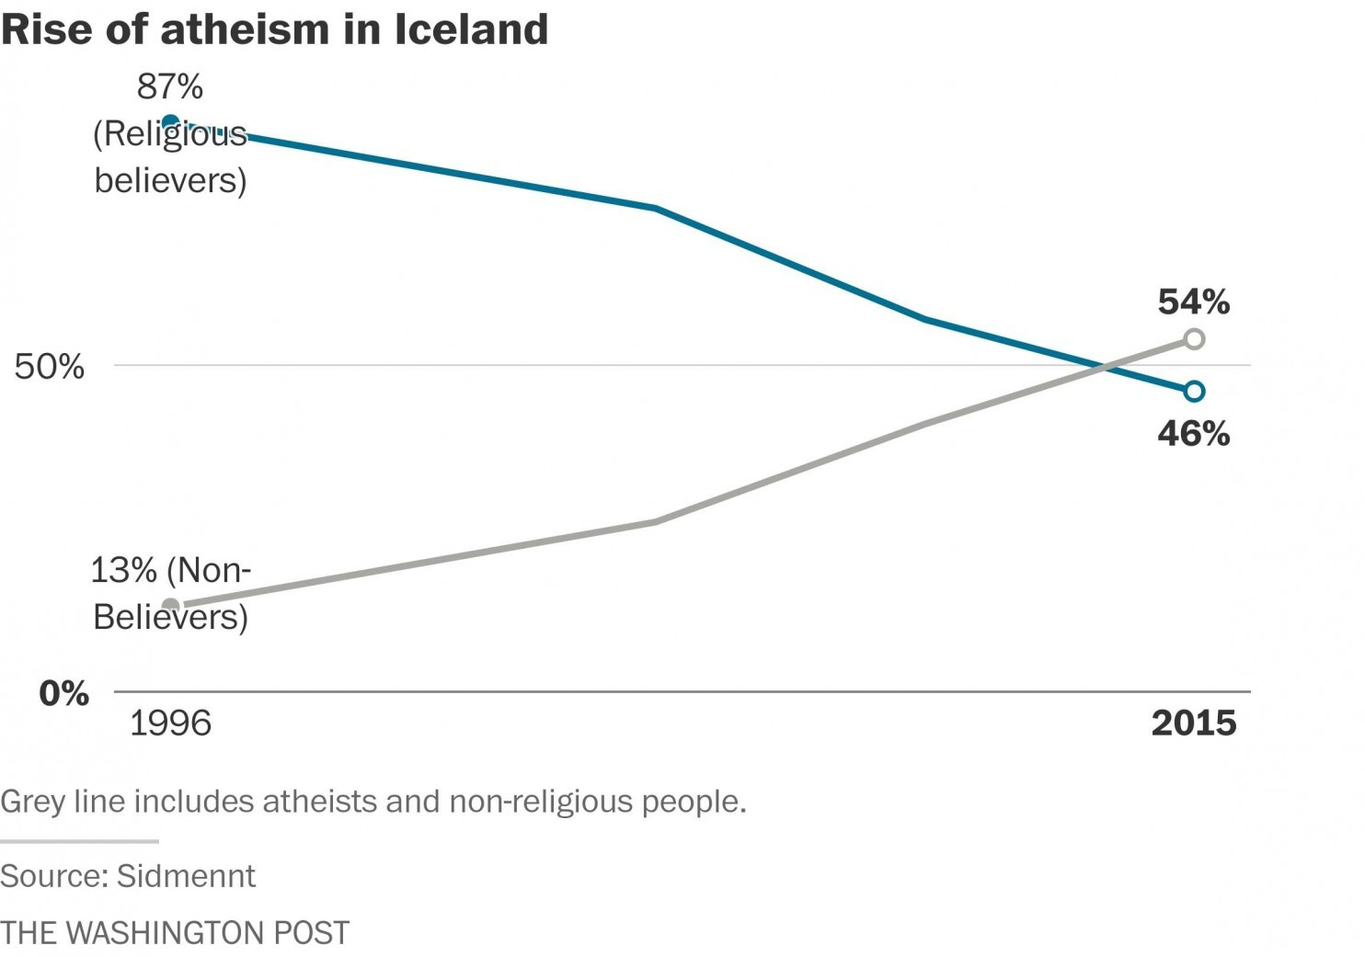
Rise of Atheism in Iceland
In this country, literally no young Christians believe that God created the Earth.
87% (Religious believers)
54%
50%
46%
13% (Non-believers)
0%
1996
2015
Notes:
"Only 20 years ago, nearly 90 percent of all Icelanders were religious believers. Today, less than 50 percent are."
____________________
https://www.washingtonpost.com/news/worldviews/wp/2016/01/23/in-this-country-literally-no-young-christians-believe-that-god-created-the-earth/
Accessed 27 Jan 2016

Slide 51
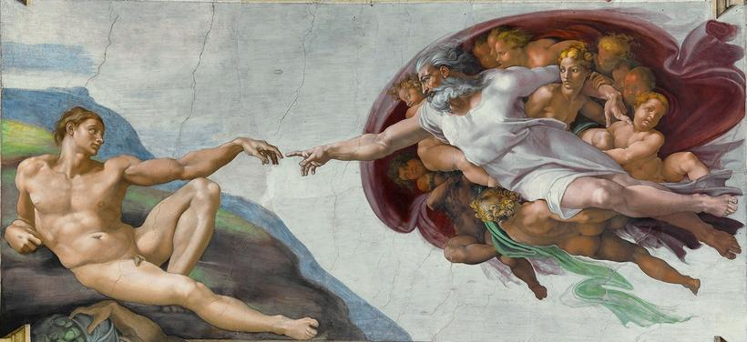
Rise of Atheism in Iceland
"A new survey gives an insight into the faith of Icelanders. In the survey, 68% of Icelanders consider themselves to be Christian but 43.4% doubt the existence of God but believe in Christian values. 17.7 percent of Icelanders believe in the creation story."
Notes:
"A new survey gives an insight into the faith of Icelanders. In the survey, 68% of Icelanders consider themselves to be Christian but 43.4% doubt the existence of God but believe in Christian values. 17.7 percent of Icelanders believe in the creation story.
The study was conducted by Siðmennt, the Icelandic Ethical Humanist Association to study what Icelanders believe in. The survey was published yesterday.
Men more religious than women
Over half of those who responded to the survey consider themselves religious but 30% say they are not religious. The survey, conducted for Siðmennt by Maskina in November 2015 selected Icelanders of both sexes aged 17- 85 from all over the country so that the answers would best reflect the nation's general ideas.
More men than women said they were religious, with 48.8 % compared to 44 % of women.
Age made a great difference: 61.3 % of people aged 55 years and older are religious whereas 17.4 % of people aged 25 or younger are religious. Over half of those aged 25 or younger say that they are not religious.
Voters of Progressive Party most religious
The least religious people of Iceland, according to the survey, live in Reykjavik or 39.2 %. Those with a university education are relatively less religious than those with secondary education exams with 38 % of those with a university education replied that they were not religious and 16.3% of people with secondary education qualifications are not religious.
Political beliefs also seemed to make a difference, with 69.9 % of people voting for the Progressive party (Framsóknarflokkurinn) saying that they were religious. Most of those who vote for the Pirate Party are not religious (30.7 %).
Just under one percent believe in Ásatrú
Those with a shorter education adher to the teachings of the Bible compared to those with a higher education. 1.9 % believe in "a good power" or a "higher power" , 0.8 percent believe in the pagan Ásatrú religion and 0.5 percent are Buddhists. 4.5 percent believe in something entirely different such as "The Goddess," "Life after death," "Nature religion," or "Philosophy."
Most believe the world was created in the Big Bang
Interestingly, 17.7 percent of people in the survey believe in the creation story, but 61.9 believe that the world was created in the Big Bang. 8.3 percent said that they didn't know or didn't have an opinion on the matter. 12.1 percent answered that they thought the world was created in a different manner or that God had created the Big Bang. Others mentioned Darwin's theory of evolution.
Over 55% of people agreed with public playschools, primary and secondary schools should remain neutral about religion. Women tend to agree more with schools being neutral about religion than men."
____________________
Iceland Monitor
26 January 2016
http://icelandmonitor.mbl.is/news/culture_and_living/2016/01/14/17_2_of_icelanders_believe_in_the_creation_story/
Accessed 27 Jan 2016

Slide 52
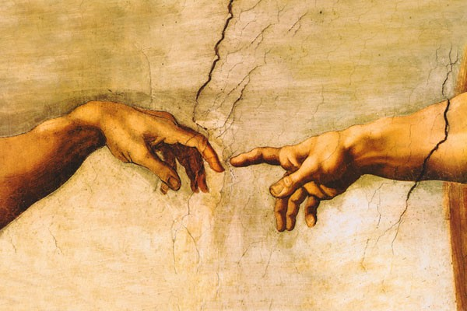
Comment on the Survey…
The Poll Question:
"How do you think the universe came to be?"
• "The universe came to be in the Big Bang"
• "God created the universe"
• "Don't know"
• "Other"
Poll by Icelandic Ethical Humanist Association
Notes:
However, one reader noted in the Comments section:
"I'm a native Icelandic speaker, and that headline is really misleading to the point of being maliciously misleading.
I commented on this on /r/Iceland yesterday, this doesn't take away from the general trend of the poll which does show that there's an accelerating generational divide in Iceland when it comes to religion with older people being much more religious than younger people.
But the question asked in the poll was confusing. It was "How do you think the universe came to be?" and the answers were "The universe came to be in the Big Bang" and "God created the universe" or "Don't know" and "Other".
Now, what many outside of Iceland and I'd say especially Americans need to understand is that even Christians in Iceland and for that matter in most of Europe don't literally believe in the origin story in the Bible in in anything but trivial numbers. Maintaining the literal interpretation of that is very much an American evangelical thing. I bet if you polled priests in Iceland and asked them whether they thought the Big Bang happened you'd get a 100% response rate in the affirmative.
But many people believe that God is the root cause of the Big Bang, and the comments in the "Other" section of the poll (page 14) are overwhelmingly about something to that effect, e.g. "God created the world in the Big Bang".
So yes, Icelanders are getting less religious, but this "0.0%" number of under 25 year olds thinking God created the world doesn't mean they're all atheist, this same poll shows that 42% of those same people consider "I'm a Christian" to be the most accurate description of their religious views.
Edit: Changed "world" to "universe" in the questions, which was just a mistranslation of mine. See comments below for some confusion related to that.
permalink
[–]needawp 1188 points 12 days ago
In fact, the largest sect of Christianity in the world of over 1.2 billion, Catholicism, actively teaches that the big bang is the way the universe was created.
____________________
Iceland Monitor
26 January 2016
http://icelandmonitor.mbl.is/news/culture_and_living/2016/01/14/17_2_of_icelanders_believe_in_the_creation_story/
Accessed 27 Jan 2016

Slide 53
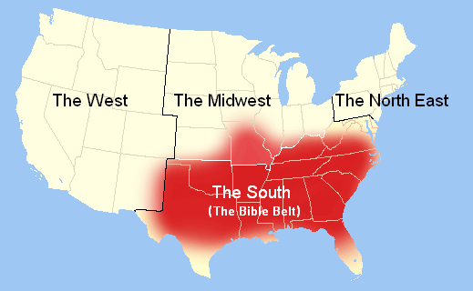
USA Bible Belt
Notes:
Sadly, believers in the USA and the West have not been “light” that shows the truth of God’s Word.
Here is the Bible Belt…

Slide 54
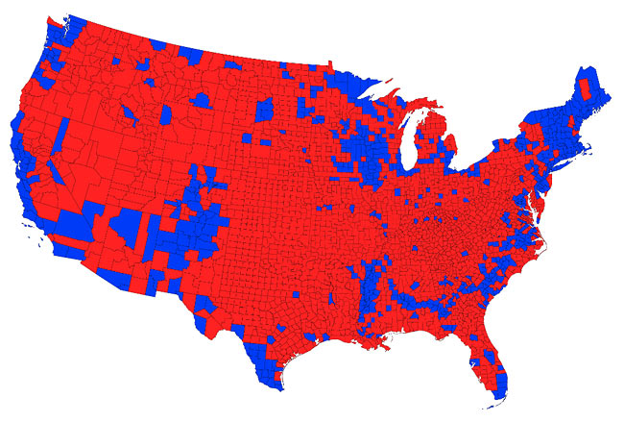
Red = Conservative Counties
Notes:
But even the Bible Belt lacks showing the light of the Bible!
Top Conservative And Liberal Cities In The United States
November 12, 2013, by Ken Jorgustin
http://modernsurvivalblog.com/current-events-economics-politics/top-conservative-and-liberal-cities-in-the-united-states/
Accessed 30 Jan 2016
Are your political views aligned with the voting statistics of your nearest city or metro/suburban proximity to that city? Do you fit in? Are you planning to move and are curious about the political viewpoints of your new area? Or are you simply curious to know which are the top conservative and liberal cities in the U.S.?
Here's your answer…
The top twenty five conservative cities in America share many common characteristics, including larger than average Caucasian populations, a large percentage of married couples, smaller city size, and higher income and education level than average.
The top twenty five conservative cities come primarily from the South, non-coastal areas of the West, and Southern California, which is indicative of a conservative voting trend in these two regions…according to the Bay Area Center for Voting Research.
The twenty-five most liberal cities in the United States share much different characteristics than their conservative counterparts—many have large African American populations, large portions of the populations are single, many are larger cities located in urban environments, and lower average levels of income and education are prevalent.
The top twentyfive liberal cities come mostly from the traditionally liberal Northeast and West coast, with a surprising number of cities near the top coming from the Midwest…according to BACVR.
Each of he following lists of top 50 conservative and liberal cities represent nearly 20% the number of cities in the United States with populations over 100,000.
Top 50 Conservative Cities Overall
1 Provo Utah 2 Lubbock Texas 3 Abilene Texas 4 Hialeah Florida 5 Plano Texas 6 Colorado Springs Colorado 7 Gilbert Arizona 8 Bakersfield California 9 Lafayette Louisiana 10 Orange California 11 Escondido California 12 Allentown Pennsylvania 13 Mesa Arizona 14 Arlington Texas 15 Peoria Arizona 16 Cape Coral Florida 17 Garden Grove California 18 Simi Valley California 19 Corona California 20 Clearwater Florida 21 West Valley City Utah 22 Oklahoma City Oklahoma 23 Overland Park Kansas 24 Anchorage Alaska 25 Huntington Beach California 26 Lancaster California 27 Tulsa Oklahoma 28 Rancho Cucamonga California 29 Garland Texas 30 Wichita Kansas 31 Santa Clarita California 32 Fullerton California 33 Corpus Christi Texas 34 Carrollton Texas 35 Anaheim California 36 Clarksville Tennessee 37 Jacksonville Florida 38 Glendale Arizona 39 Waco Texas 40 Pasadena Texas 41 Chesapeake Virginia 42 Scottsdale Arizona 43 Springfield Missouri 44 Fort Wayne Indiana 45 Naperville Illinois 46 Oceanside California 47 Chandler Arizona 48 Costa Mesa California 49 Modesto California 50 Sioux Falls South Dakota
Top 50 Liberal Cities Overall
1 Detroit Michigan 2 Gary Indiana 3 Berkeley California 4 District of Columbia 5 Oakland California 6 Inglewood California 7 Newark New Jersey 8 Cambridge Massachusetts 9 San Francisco California 10 Flint Michigan 11 Cleveland Ohio 12 Hartford Connecticut 13 Paterson New Jersey 14 Baltimore Maryland 15 New Haven Connecticut 16 Seattle Washington 17 Chicago Illinois 18 Philadelphia Pennsylvania 19 Birmingham Alabama 20 St. Louis Missouri 21 New York New York 22 Providence Rhode Island 23 Minneapolis Minnesota 24 Boston Massachusetts 25 Buffalo New York 26 New Orleans Louisiana 27 Ann Arbor Michigan 28 Jersey City New Jersey 29 Portland Oregon 30 Daly City California 31 Atlanta Georgia 32 Dallas Texas 33 Hayward California 34 Madison Wisconsin 35 Pittsburgh Pennsylvania 36 St. Paul Minnesota 37 Los Angeles California 38 Rochester New York 39 Memphis Tennessee 40 Milwaukee Wisconsin 41 Vallejo California 42 Dayton Ohio 43 Bridgeport Connecticut 44 Springfield Massachusetts 45 Syracuse New York 46 Jackson Mississippi 47 Jackson Mississippi 48 Akron Ohio 49 Denver Colorado 50 Richmond Virginia
Top 10 Liberal Major Cities (over 300,000 population)
1. Detroit 2. D.C. 3. Oakland 4. San Francisco 5. Cleveland 6. Baltimore 7. Seattle 8. Chicago 9. Philadelphia 10. St. Louis
Top 10 Conservative Major Cities (over 300,000 population)
1. Colorado Springs 2. Mesa 3. Arlington 4. Oklahoma City 5. Tulsa 6. Wichita 7. Anaheim 8. Jacksonville 9. Omaha 10. Houston
data acquired via Center for Voting Research (BACVR)
Another way to look at the political landscape is a very interesting one… a 'cartogram', where the area of spaces on a map is determined by a variable other than geographic area. In this case, it's population: Make the most populous counties proportionately larger than the least populous counties.
84 percent of Americans live in the largest 25 percent of counties. 50 percent of the population lives in 5 percent of counties.
Here is the traditional red-blue (conservative-liberal) map of counties and how they voted overall…

Slide 55
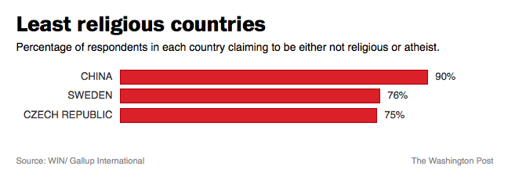
Least Religious Countries
Notes:
"The world's most populous country is also the globe's least religious. According to a new study, 90 percent of all Chinese consider themselves to be atheists or not to be religious."
_________
Map: These are the world's least religious countries
The Washington Post By Rick Noack April 14, 2015
https://www.washingtonpost.com/news/worldviews/wp/2015/04/14/map-these-are-the-worlds-least-religious-countries/?tid=a_inl
Accessed 27 Jan 2016

Slide 56
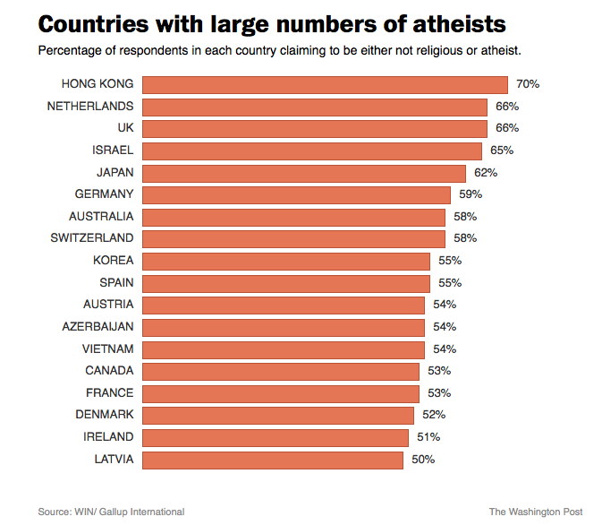
Least Religious Countries
Notes:
"The study also sheds light at other differences in religious habits that are unrelated to national borders. The survey's authors found that people younger than 34 tend to be more religious than older respondents. This is particularly surprising from a U.S. perspective where an increasing number of younger citizens do not identify with any religion at all — contrary to older Americans.
The researchers also examined other variables apart from age. "Those without what is considered an education are the most religious but religious people are a majority in all educational levels," they concluded.
_________
Map: These are the world's least religious countries
The Washington Post By Rick Noack April 14, 2015
https://www.washingtonpost.com/news/worldviews/wp/2015/04/14/map-these-are-the-worlds-least-religious-countries/?tid=a_inl
Accessed 27 Jan 2016

Slide 57
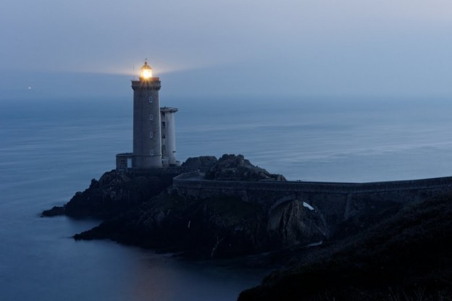
Be Light
Subtitle
Notes:
But why do we want to reveal truth? This is to give people direction towards God like a lighthouse shows ships how to avoid the rocks while going into harbor.

Slide 58
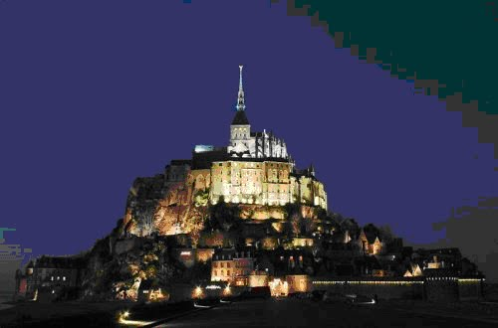
What's the point about the city on a hill?
Subtitle
Notes:
“The image is of a brightly lit city on a hill–top, representing the corporate effect of the combined ‘lights’ of individual disciples” (New Bible Commentary, 910).

Slide 59
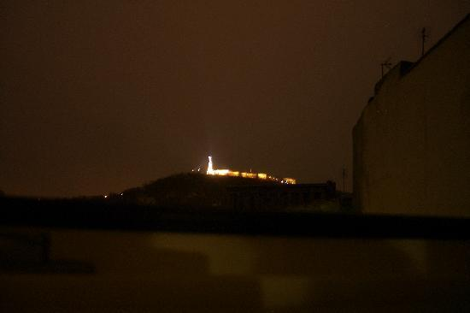
A City on a Hill
Subtitle
Notes:
If it was a dark night and you were traveling down the road in the dark but saw ahead a brightly lit city, would you just say, “Hey, I’m tired. I’ll just sleep right here next to the road in the dark”? No.

Slide 60
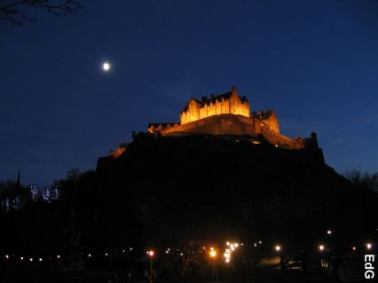
A City on a Hill
Subtitle
Notes:
Wouldn’t you be drawn to a brightly lit city? There you would find a sense of security, protection, and joy.

Slide 61
A City on a Hill
Subtitle
Notes:
Likewise, as a church we should draw people to us as they see our light. They should feel secure with us—and sense our joy in Christ!

Slide 62
"Neither do people light a lamp and put it under a bowl. Instead they put it on its stand, and it gives light to everyone in the house" (5:15 NIV).
Subtitle
Notes:
Jesus makes the same point with the lighting of a lamp.
When the lamp is lit, you can see your way around which keeps you from making silly mistakes.
But how silly it is to have a lamp lit but then put it under a bowl! What use is that? In fact, it’s a waste! It uses up the bulb for no benefit, it wastes electricity when you can’t even see better, and, in our case, the cord becomes a hazard in the dark!

Slide 63
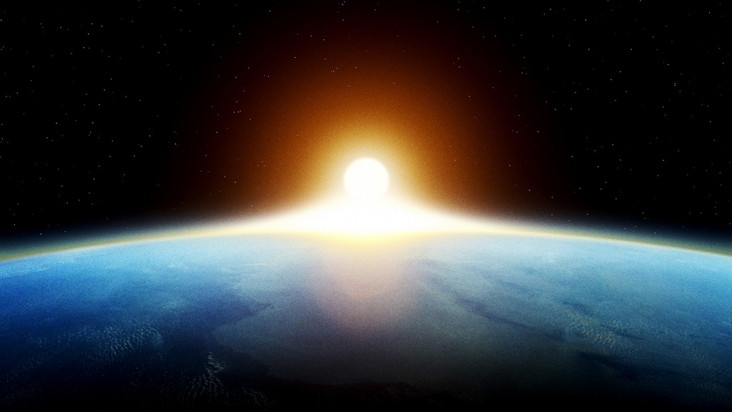
Be "light" through your good deeds to help others praise God (5:16).
But how?
Notes:
Use your influence for good (God). For “good” and for “God” are essentially the same thing, though there is no etymological connection between these words.
This is what Christ meant by not lighting a lamp and putting it under a bowl.
So how can you be a better “let your light shine before men, that they may see your good deeds and praise your Father in heaven”?

Slide 64
Use your position and privileges to influence people for God.
Subtitle
Notes:
I have ministry privileges that enable me to be a light:
As a professor, I influence my students, but how?
As a pastor, God gives me the privilege to try to influence you as I speak right now!

Slide 65
NT Sermons link at biblestudydownloads.org
Get this presentation and script for free!
Notes:
As a web author, I can post all my teaching online to be a light throughout the world.

Slide 66
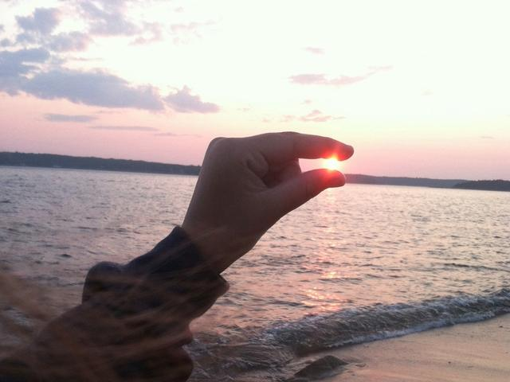
You have privileges that I don't have!
Subtitle
Notes:
I have zero influence at your school, neighborhood, or place of work.
They have no clue who “Rick Griffith” is, but they know you!
Now, do they know Christ better because they know you? Be His light!
What about those of us who don’t feel we can influence others much?

Slide 67
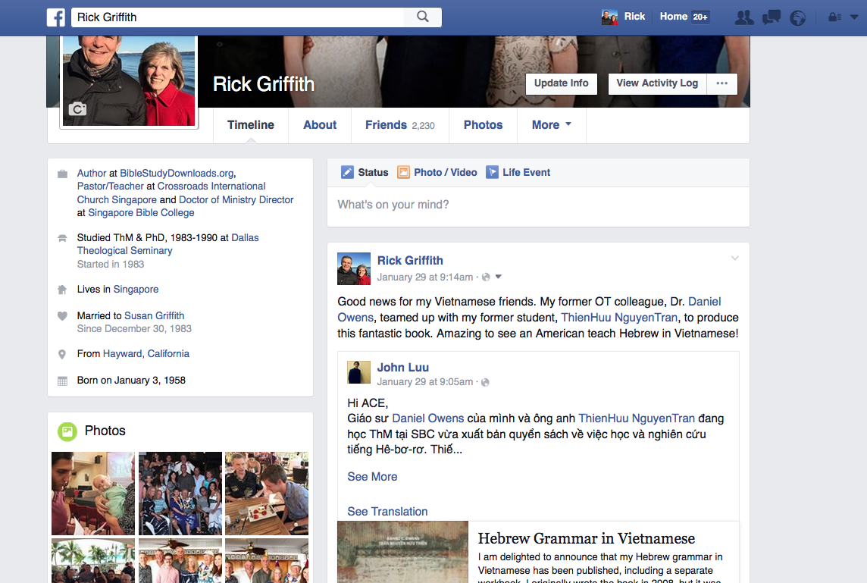
Be a Light Through Facebook
Subtitle
Notes:
Well, use facebook! It is the great equalizer. We all have equal opportunity to post things that will build others up! So do it.

Slide 68
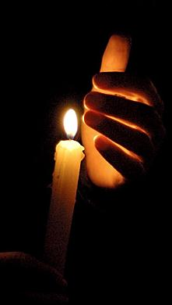
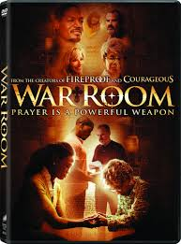
Loan DVDs & Books
Notes:
You may not be able to say what you want to say very well, but someone else can. So loan books and DVDs to others.

Slide 69
How can we bless others?
Salt & Light

Slide 70
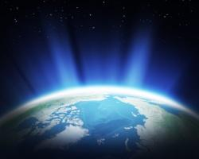
Direct others to God.
Main Idea

Slide 71
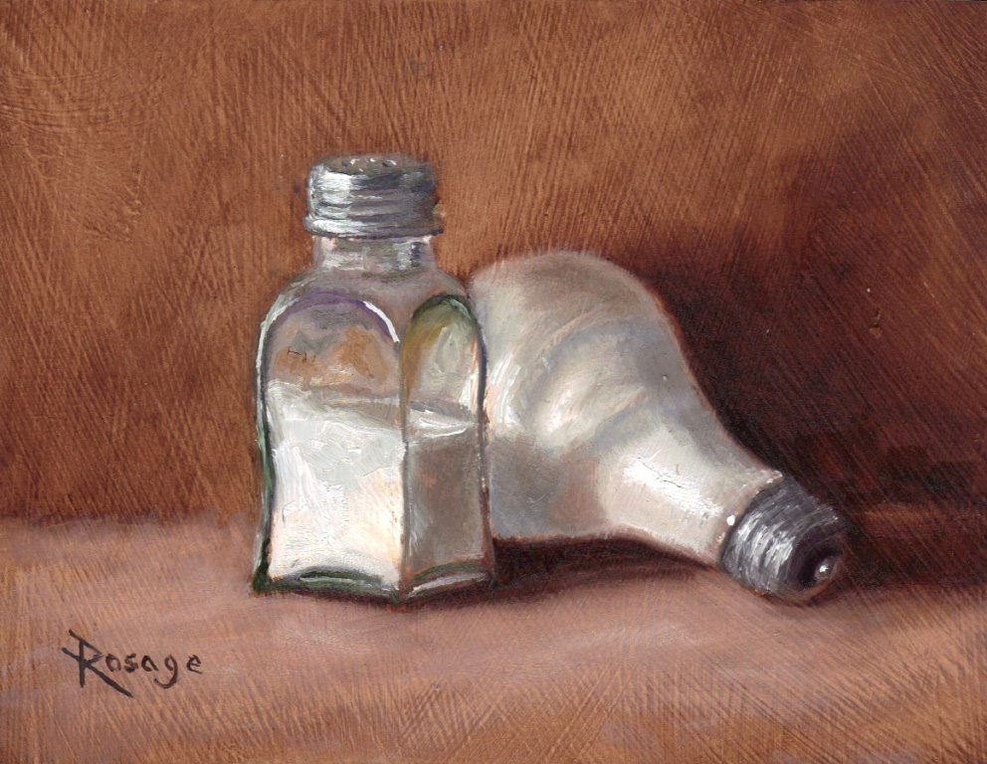
Direct others to God.
Main Idea
Notes:
Influence people to follow God (MI restated).
Impact others for good (MI restated).
Show people God (MI restated).

Slide 72
I. Help people hunger for God (13).
Subtitle
Notes:
Like salt, help people hunger for God (5:13).

Slide 73
II. Lead people to God so they'll praise him (5:14-16).
Subtitle
Notes:
Like light, lead people to God so they’ll praise him (5:14-16).

Slide 74
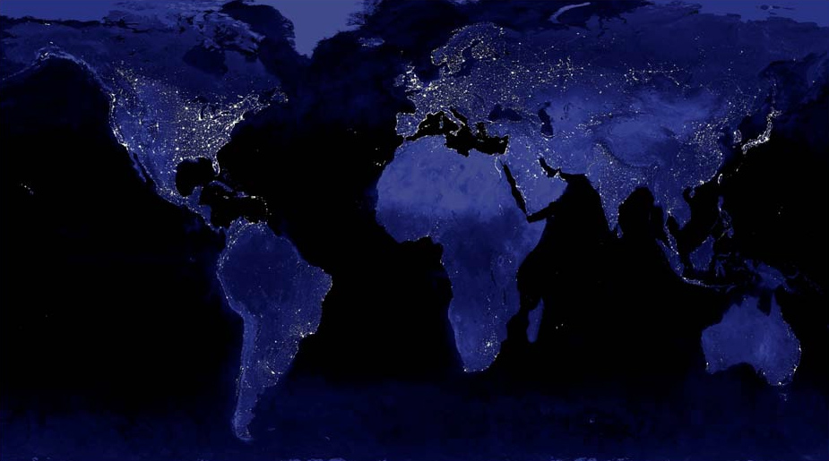
Be involved…
"Both metaphors of salt and light raise important questions about Christian involvement in society regarding all forms of separatism or withdrawal. We are not called to control secular power structures; neither are we promised that we can Christianize the legislation and values of the world. But we must remain active preservative agents, indeed irritants, in calling the world to heed God's standards. We dare not form isolated Christian enclaves to which the world pays no attention."
Craig Blomberg, Matthew, NAC (Nashville: Broadman, 1992), 103

Slide 75
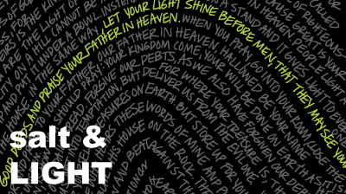
Salt & Light
Subtitle
Notes:
Put simply, we need to direct others to God.

Slide 76
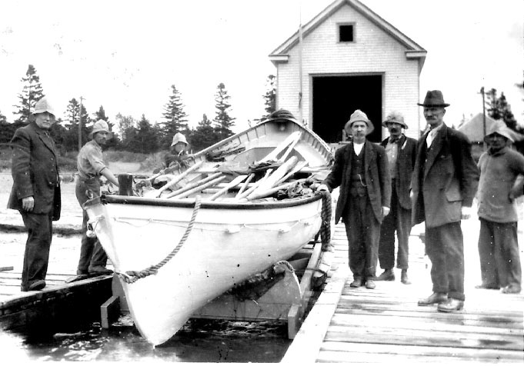
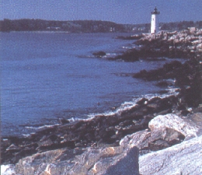
The Life-Saving Station
Notes:
76
READ:
On a dangerous seacoast where shipwrecks often occur there once was a life-saving station. The building was just a hut, but the devoted members went daily out to sea and saved many persons who otherwise would have drowned. As more people were saved, more crews were trained, and more lives saved. The little life-saving station grew.
However, some of those saved years before became concerned that the building was inadequately supplied. So they threw away the cots and bought beds, feeling that those saved from the sea should have a more comfortable place. Soon the building became very lavishly furnished and the members used it as sort or a club. Fewer members were interested in going out on life-saving missions so crews were hired to do this work. Yet there still was a liturgical lifeboat in the meeting room where the club's meetings were held.
Soon after this, a large ship was wrecked on their coast. The hired crews brought boatloads of people into the building. They were wet, half-drowned, and had different colored skin. The club was in chaos, as this hindered the normal social life of the club, so the property committee immediately had shabby building built outside rather than letting these people into their beautiful building.
At the next meeting there was a split in the membership. Most of the members wanted to stop life-saving activities altogether, as this was a hindrance to the club's activities. Others insisted that they were still called a life-saving station, but they were voted down and told that if they wanted to save the kinds of people ship-wrecked in those waters, they should begin their own life-saving station down the coast. They did.
History continued to repeat itself. The new station soon evolved into a club, and yet another life-saving station was formed. Shipwrecks are still frequent in those waters, but most of the people drown.

Slide 77
NT Sermons link at biblestudydownloads.org
Get this presentation and script for free!

Slide 78
Black

